Slide 1
Variational Autoencoder(VAE)
Generative Model

Slide 2
Generative Models

Slide 3






Autoencoder
$$E$$
$$D$$
$$\hat{x}$$
$$x$$
$$ℒ={(x−\hat{x})}^{2}$$
$$ℒ={(x−D(E\left(x\right)))}^{2}$$

Slide 4
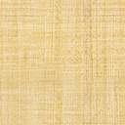
Data Generation Process
Sampler
$$D$$
Latent Space
$$\hat{x}$$

Slide 5
Problems with Autoencoder
Autoencoder can not generate the new data
Latent space is not regularized
Latent space is not continuous and complete

Slide 6
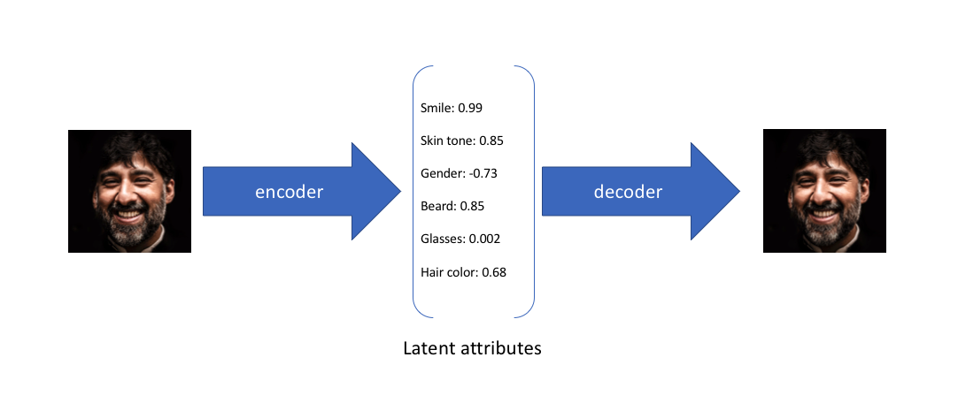
Autoencoder
https://www.jeremyjordan.me/variational-autoencoders/

Slide 7
Latent Space
Hair Color
Smile
Gender
Glasses

Slide 8
Hair Color
Smile
Gender
Glasses
Smile
Hair Color
Gender
Glasses

Slide 9
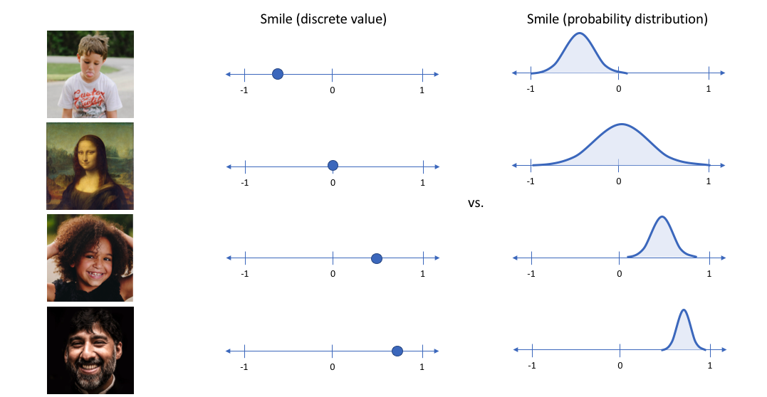
Latent space encoding
https://www.jeremyjordan.me/variational-autoencoders/

Slide 10
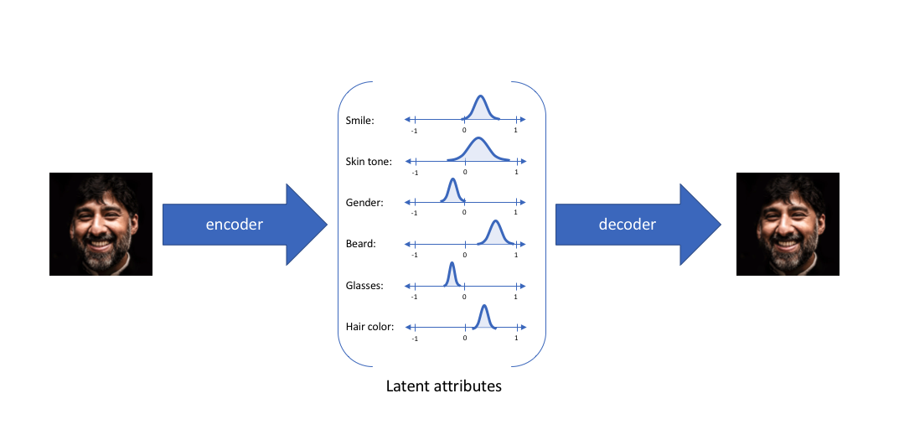
Latent space encoding
https://www.jeremyjordan.me/variational-autoencoders/

Slide 11
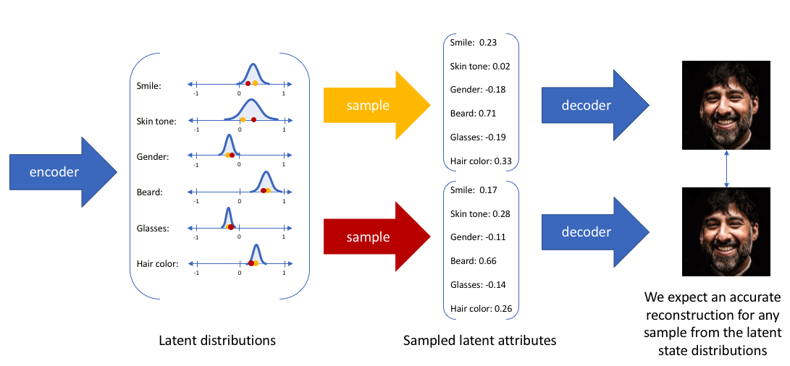
https://www.jeremyjordan.me/variational-autoencoders/

Slide 12



Variational Autoencoder(VAE)
$$E$$
$$D$$
$$z$$
$$p(x|z)$$
$$\hat{x}$$
$$x$$
$$q(z|x)$$
$$ℒ={(x−\hat{x})}^{2}+ KL( 𝒩(μ_{x},σ_{x})||𝒩(0,1)||)$$
Kullback-Leibler Divergence

Slide 13








Variational Autoencoder(VAE)
$$μ_{1}$$
$$E$$
$$μ_{2}$$
$$D$$
$$μ_{3}$$
$$p(x|z)$$
$$\hat{x}$$
$$x$$
$$q(z|x)$$
$$σ_{1}$$
$$σ_{2}$$
$$σ_{3}$$
$$Sample$$
$$ℒ={(x−\hat{x})}^{2}+ KL( 𝒩(μ_{x},σ_{x})||𝒩(0,1)||)$$
Kullback-Leibler Divergence

Slide 14
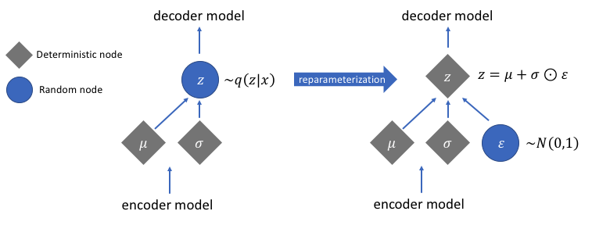
Reparameterization Trick
https://www.jeremyjordan.me/variational-autoencoders/

Slide 15
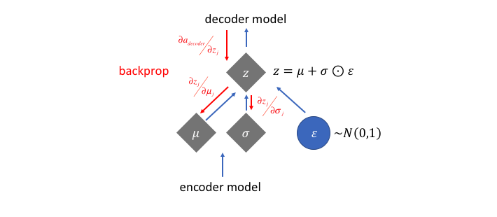
Reparameterization Trick
https://www.jeremyjordan.me/variational-autoencoders/

